Slide 1


Flyweight DESIGN (ANTY-)PATTERNS Coffee Break
Peter Prazenica

Slide 2
Flyweight - Intent
GoF: “Use sharing to support large numbers of fine-grained objects efficiently.”

Slide 3
Flyweight - Intent
GoF: “Use sharing to support large numbers of fine-grained objects efficiently.”
A flyweight is an object that minimizes memory usage by sharing as much data as possible with other similar objects; it is a way to use objects in large numbers when a simple repeated representation would use an unacceptable amount of memory.

Slide 4
Flyweight - Intent
GoF: “Use sharing to support large numbers of fine-grained objects efficiently.”
Structural Design Patterns: Adapter, Bridge, Composite, Decorator, Facade, Flyweight, Private Class Data, Proxy

Slide 5

Flyweight Example I -
It might be desirable to have, for each character in a document, a glyph object containing its font family name, font size and other formatting data, but this would amount to hundreds or thousands of bytes for each character.

Slide 6
Flyweight Example I -
It might be desirable to have, for each character in a document, a glyph object containing its font family name, font size and other formatting data, but this would amount to hundreds or thousands of bytes for each character.
Instead, for every character there might be a reference to a flyweight glyph object shared by every instance of the same character in the document; only the position of each character (in the document and/or the page) would need to be stored internally.

Slide 7
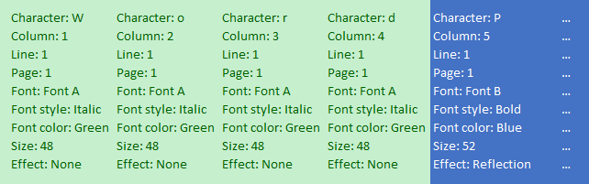
Flyweight Example I -
The following data structure
can be transformed into:

Slide 8

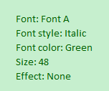

Flyweight Example I -

Slide 9

Flyweight Example I -
Extrinsic, mutable, variant state, context dependent, stateful, non shareable
Intrinsic, immutable, invariant state, context independent, stateless, shareable

Slide 10
Flyweight - How to implement
Divide fields of a class into intrinsic and extrinsic

Slide 11
Flyweight - How to implement
Divide fields of a class into intrinsic and extrinsic
Leave the intrinsic fields in the class, make them immutable

Slide 12
Flyweight - How to implement
Divide fields of a class into intrinsic and extrinsic
Leave the intrinsic fields in the class, make them immutable
Methods that use extrinsic fields should receive them as parameters

Slide 13
Flyweight - How to implement
Divide fields of a class into intrinsic and extrinsic
Leave the intrinsic fields in the class, make them immutable
Methods that use extrinsic fields should receive them as parameters
Optionally, create a factory class to manage the pool of flyweights

Slide 14
Flyweight - How to implement
Divide fields of a class into intrinsic and extrinsic
Leave the intrinsic fields in the class, make them immutable
Methods that use extrinsic fields should receive them as parameters
Optionally, create a factory class to manage the pool of flyweights
The client must store or calculate extrinsic parameters of the methods

Slide 15
Flyweight - How to implement
Divide fields of a class into intrinsic and extrinsic
Leave the intrinsic fields in the class, make them immutable
Methods that use extrinsic fields should receive them as parameters
Optionally, create a factory class to manage the pool of flyweights
The client must store or calculate extrinsic parameters of the methods
Optionally, the extrinsic state along with the flyweight-referencing field may be moved to a separate context class

Slide 16
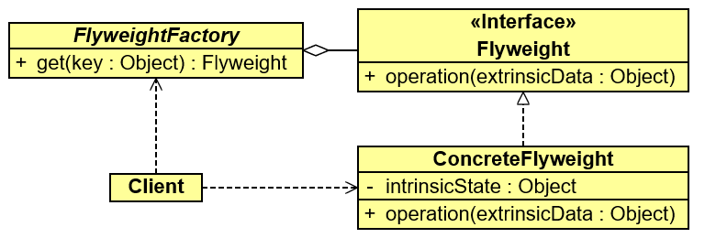
Flyweight – UML – Class Diagram

Slide 17
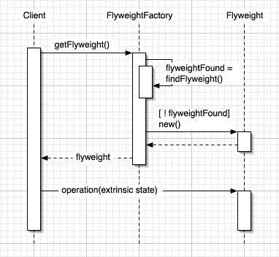
Flyweight – UML – Sequence Diagram

Slide 18
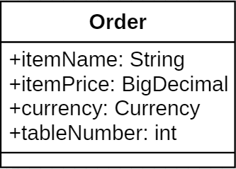
Flyweight Example II - Restaurant
1. Divide fields of a class into intrinsic and extrinsic
Intrinsic, immutable, shareable
+ itemName: String
+ itemPrice: BigDecimal
+ currency: Currency
Extrinsic, mutable, non shareable
+ tableNumber: int

Slide 19
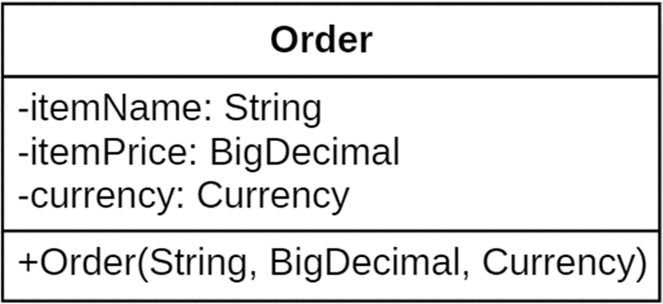
Flyweight Example II - Restaurant
2. Leave the intrinsic fields in the class, make them immutable
Intrinsic, immutable, shareable
+ itemName: String
+ itemPrice: BigDecimal
+ currency: Currency
(later on it will be renamed to MenuItem)

Slide 20
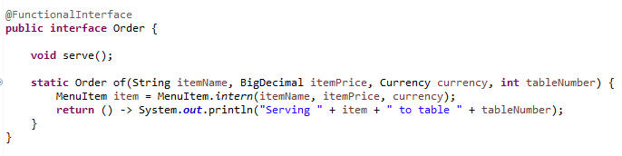
Flyweight Example II - Restaurant
3. Methods that use extrinsic fields should receive them as parameters
Extrinsic, mutable, non shareable
+ tableNumber: int

Slide 21
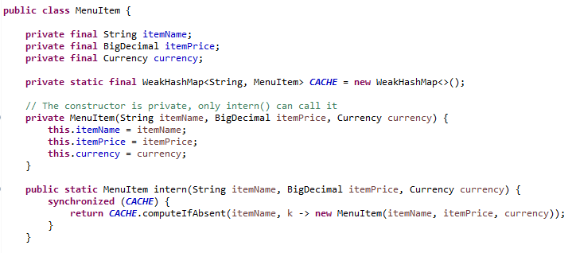
Flyweight Example II - Restaurant
4. Optionally, create a factory class to manage the pool of flyweights

Slide 22
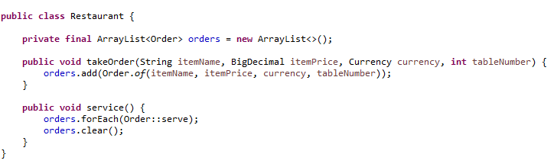
Flyweight Example II - Restaurant
5. The client must store or calculate extrinsic parameters of the methods

Slide 23
Flyweight Example II - Restaurant
6. Optionally, the extrinsic state along with the flyweight-referencing field may be moved
to a separate context class

Slide 24
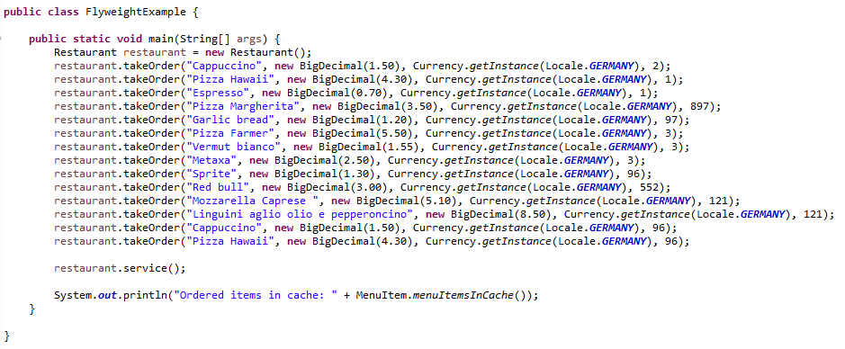
Flyweight Example II - Restaurant

Slide 25
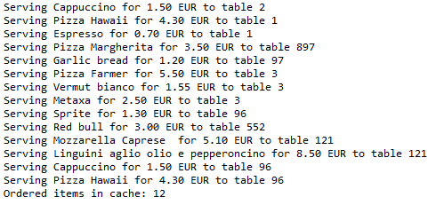
Flyweight Example II - Restaurant
Number of orders = 14

Slide 26
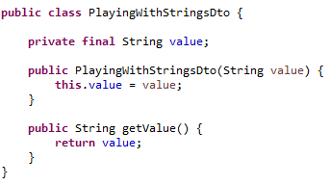
Flyweight Example III – String Interning
Our Data Transfer Object (DTO) contains 1 String value

Slide 27
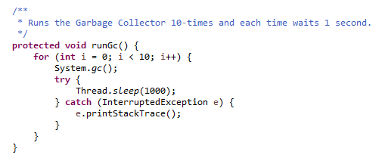
Flyweight Example III – String Interning
The parent class “PlayingWithStringsAbstract” contains 3 auxiliary methods

Slide 28
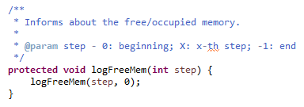
Flyweight Example III – String Interning
The parent class “PlayingWithStringsAbstract” contains 3 auxiliary methods

Slide 29
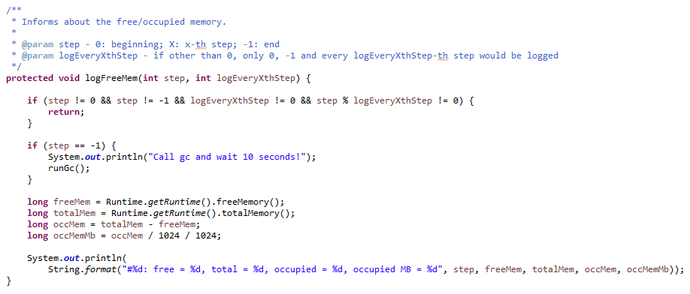
Flyweight Example III – String Interning
The parent class “PlayingWithStringsAbstract” contains 3 auxiliary methods

Slide 30
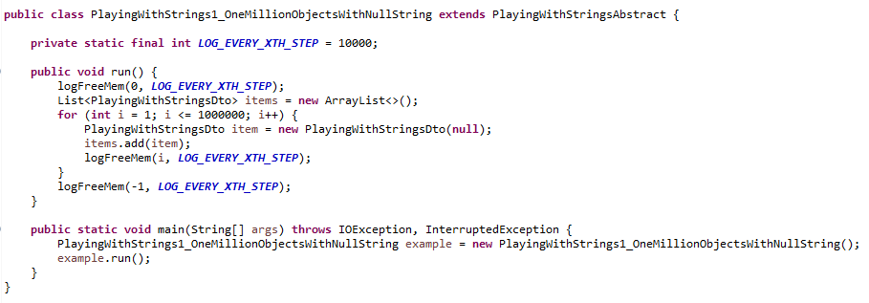
Flyweight Example III – String Interning
A) Let’s create 1000 000 of DTOs with null value

Slide 31

Flyweight Example III – String Interning
A) Let’s create 1000 000 of DTOs with null value

Slide 32
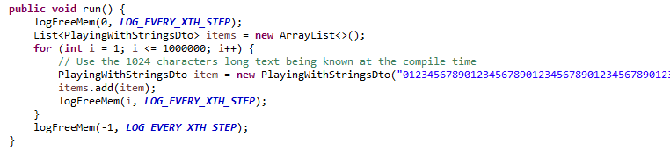
Flyweight Example III – String Interning
B) Let’s create 1000 000 of DTOs with 1024 long text (always the same)

Slide 33
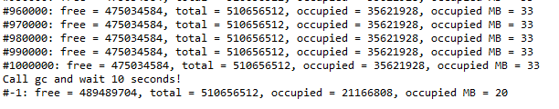
Flyweight Example III – String Interning
B) Let’s create 1000 000 of DTOs with 1024 long text (always the same)
We have created 1000 000 x 1024 long text, however, the occupied memory stays as the same.

Slide 34
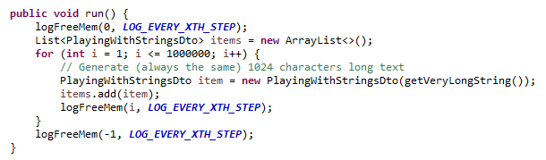
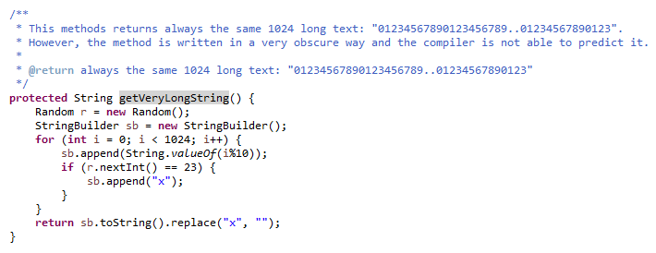
Flyweight Example III – String Interning
C) Let’s create 1000 000 of DTOs with generated 1024 long text

Slide 35
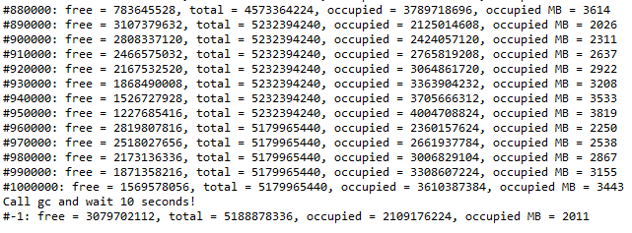
Flyweight Example III – String Interning
C) Let’s create 1000 000 of DTOs with generated 1024 long text
Finally the application
behaves as expected.
The amount of occupied
memory is >= 2 GB

Slide 36
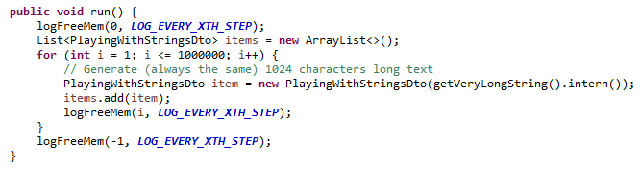
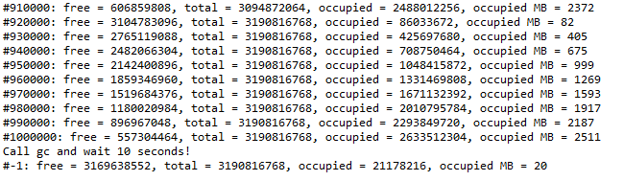
Flyweight Example III – String Interning
D) Let’s modify the C) variant by calling the “intern” method on every generated String
We are back at 20 MB.

Slide 37
Flyweight - String Interning
String interning is a method of storing only one copy of each distinct String value, which
must be immutable.
The single copy of each string is called its intern and is typically looked up by a method of the string class, for example String.intern() in Java. All compile-time constant strings in Java are automatically interned using this method.
When the intern method is invoked, if the pool already contains a string equal to this String
object as determined by the equals(Object) method, then the string from the pool is returned.
Otherwise, this String object is added to the pool and a reference to this String object is returned.
Objects other than strings can be interned. For example, in Java, when primitive values are boxed into a wrapper object, certain values (any boolean, any byte, any char from 0 to 127, and any short or int between −128 and 127) are interned, and any two boxing conversions of one of these values are guaranteed to result in the same object.

Slide 38
Flyweight – Applicability
Use the Flyweight pattern only when your program must support a huge number of objects which barely fit into available RAM.
It’s most useful when:
an application needs to spawn a huge number of similar objects
this drains all available RAM on a target device
the objects contain duplicate states which can be extracted and shared between multiple objects

Slide 39
Flyweight – Pros and Cons
You can save lots of RAM, assuming your program has tons of similar objects.
You might be trading RAM over CPU cycles when some of the context data needs to be recalculated each time somebody calls a flyweight method.
The code becomes much more complicated. New team members will always be wondering why the state of an entity was separated in such a way.

Slide 40
Flyweight - Relations with Other Patterns
You can implement shared leaf nodes of the Composite tree as Flyweights to save some RAM.
Flyweight shows how to make lots of little objects, whereas Facade shows how to make a single object that represents an entire subsystem.
Terminal symbols within Interpreter's abstract syntax tree can be shared with Flyweight.
Flyweight explains when and how State objects can be shared.
Flyweight would resemble Singleton if you somehow managed to reduce all shared states of the objects to just one flyweight object. But there are two fundamental differences between these patterns:
There should be only one Singleton instance, whereas a Flyweight class can have multiple instances with different intrinsic states.
The Singleton object can be mutable. Flyweight objects are immutable.

Slide 41

Flyweight - Discussion

Slide 42
Flyweight - References
Safari Books
Design Patterns and Best Practices in Java https://learning.oreilly.com/library/view/design-patterns-and/9781786463593/58c92a6e-429d-44cc-b734-3d672c0fe281.xhtml
Design Patterns in Java, Second Edition https://learning.oreilly.com/library/view/design-patterns-in/9780321630483/ch13.html
Online Sites
https://refactoring.guru/design-patterns/flyweight
https://sourcemaking.com/design_patterns/flyweight
https://en.wikipedia.org/wiki/Flyweight_pattern
http://www.blackwasp.co.uk/Flyweight.aspx
https://www.geeksforgeeks.org/flyweight-design-pattern/

